Slide 1
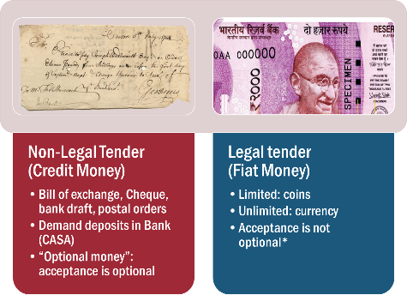

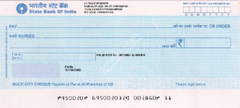
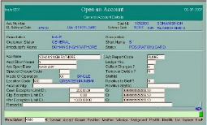


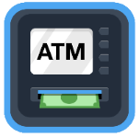




Post demonetization -> Bank Money & Digital Payment
Commodity Money
Metallic Money
Paper Money
Bank Money
Crypto Currency
CBS
Notes:
Virtual Currency …(Bitcoin)

Slide 2

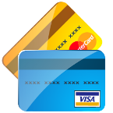
Banking transactions:
Bank account
Current Account
Savings Account
Bank Money
Paper order
Electronic Orders
Payment
Spot
Deferred
FD/RD….
Fiat money

Slide 3
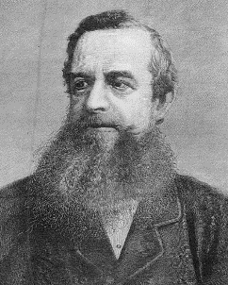
Viceroy Ripon (1880-84)
Bank Money
Lord Lytton: Vernacular press act to gag Indian media…..Ripon repealed
81: First Factory act
82: Magna Carta of Local self gov. (FATHER)
82: Hunter commission on Edu.
83: ilbert Bill’: Indian judge can’t try European
Negotiable Instruments Act, 1881.. to encourage cheque usages and to punish dishonor & forgery
Notes:
feared that, unlike British judges, Indian judges would not overlook their mistreatment of Indian workers. At the same time, rumours began circulating of an English female being raped by an Indian in Calcutta. In reference to the Indian Rebellion of 1857, when it was alleged that English women and girls were raped by Indian sepoys, many British colonialists expressed great concern over the humiliation English females would have to face appearing before Indian judges in the case of rape.[2] The British press in India even spread wild rumours about how Indian judges would abuse their power to fill their harems with white English females.

Slide 4
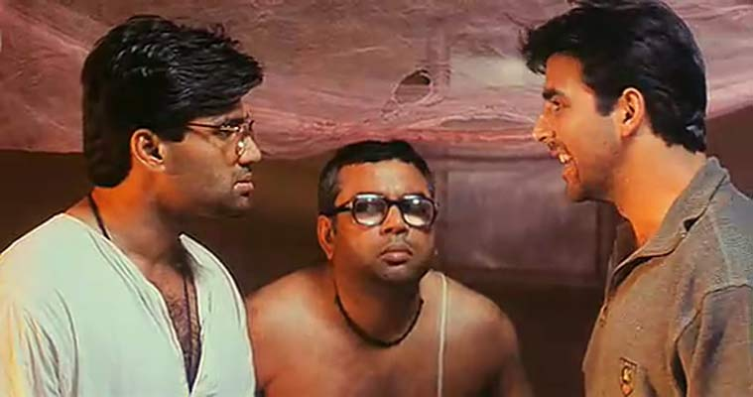
Bill of exchange : 3 parties. Stamp duty Rs.1.25 (in 1899)
Bill of Exchange
@Shyam, give Rs.500 to Baburao on 31st Feb.
- Signed by Raju
Shyam
Baburao
Raju

Slide 5

Negotiable Instruments Act, 1881- Types
bills of exchange
3 parties: Raju: @Shyam please pay Rs.500 to Baburao on 31st Feb. requires 'stamping‘;
cheques
No 'stamping', but sign req, may be crossed
by usage or custom
Hundis,Share warrants, Dividend warrants, Bankers draft, Circular notes, Bearer debentures, Railway receipts, Delivery orders.
3 parties: drawer, Drawee (Bank), Payee (recipient)
Promissory notes
I promise to pay bearer the sum of __ = [2 parties]
Not fiat-money though.
Notes:
Participatorynotes.
Hundi: indigenous negotiable instrument

Slide 6
1881->Amendment 2015-> notified in 2016, Jan
Jurisdiction
Receiver/Payee’s branch.
frequent fraudster
Centralizing of cases mandatory
Not @place of issue
Dishonor (section 138)
Insufficient funds in drawer’s account
Notes:
estimated 18 lakh cheque bounce cases across the country, of which about 38,000 are pending in high courts.

Slide 7
UPSC Mains exam: GS Paper-II
Discuss Section 66A of IT Act, with reference to its alleged violation of Article 19 of the Constitution. (GSM2-2013)
Bring out the circumstances in 2005 which forced amendment to section 3(d) in the India n Patent Law, 1970. (GSM3-2013)
Section 138 of NI Act

Slide 8
Cheque types: Based on time
Cheque
Stale
Post dated
Anti Dated
Before a specific date
After a specific date
Not withdrawn in 3 months

Slide 9
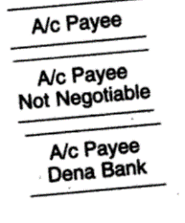
Cheque crossing
No crossing (Open cheques)
& co [General crossing]
Payee’s Accounts only
Special crossing
@specific bank where it must be deposited
Stolen cheque can be encashed by wrong person
Transferable to third party (“negotiable”) or “Not Negotiable”.
No cash, only deposit to account
Non-tranferable
Cheque
Order (Crossed)
Open (Bearer)
Traveler cheque
General
specific
Anyone who presents
Notes:
When person doesn’t have bank account.
https://books.google.co.in/books?id=nNo7874TM2MC&pg=PA82&dq=types+of+crossing+cheque&hl=en&sa=X&redir_esc=y#v=onepage&q=types%20of%20crossing%20cheque&f=false
, if the cheque was stolen, the person from whom the cheque was stolen might recover the amount of the cheque from the person who received payment, even though that person who received it may have done nothing wrong.
1. Yes, A/c Payee means the payment must be made to the Payee who is maintaining an account (With any bank, etc) 2. Suppose the cheque is in favour of Mr.X, who does not have any bank account. 3. In this case, he can endorse that the cheque is negotiated to Mr.Y. 4. The payment may be made to Mr.Y through his bank account. 5. By this, it is ensured that the payment shall be through a existing account only. So no mal-practice may happen. 6. A further security is the prevention of such negotiation as told above. 7. By this, negotiation/ endorsement is stopped. Hence this is called, Non Negotiable Cheque.

Slide 10
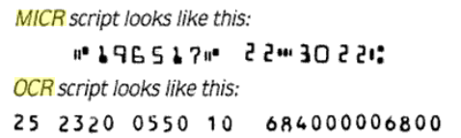
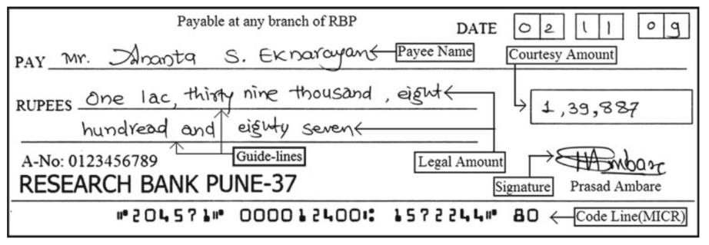
Cheque clearance
Cheque clearance
Manual
Automated clearing system (ACS)
MICR (Iron oxide) 1986’India
Magnetic ink character recognition
OCR:
Optical character recognition

Slide 11


MICR cheque: Sample
Valid for 3 months
Indian financial system code
IFSC code: 11 alphanumeric
First four: bank name
Fifth: always 0
Last 6: branch
At par
Cheque number
9 digit MICR code
First 3 digit: city
Next 3 digits: bank
Last 3 digits: branch

Slide 12
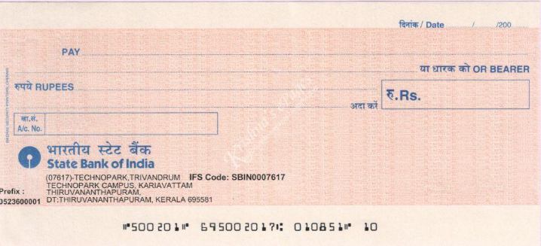
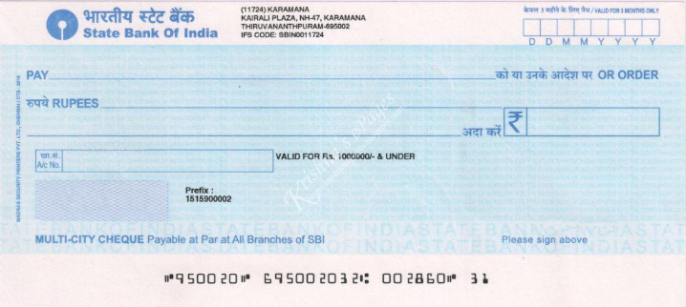
Local Cheque vs At Par Cheque
Outstation cheque:
collection charges 25-50-more depending on amount + Service tax
Notes:
https://www.rbi.org.in/Scripts/FAQView.aspx?Id=78
Banks cannot charge more than the following for outstation cheques:
Up to and including Rs.5000 – Rs.25 per instrument + service tax; Above Rs.5000 and Up to and including Rs.10,000 – not exceeding Rs.50 per instrument+ service tax; Above Rs.10,000 and up to and including Rs.1, 00,000 – not exceeding Rs.100 per instrument + service tax; Rs.1, 00,001 and above – left to the banks to decide. No additional charges such as courier charges, out of pocket expenses, etc., should be levied.

Slide 13
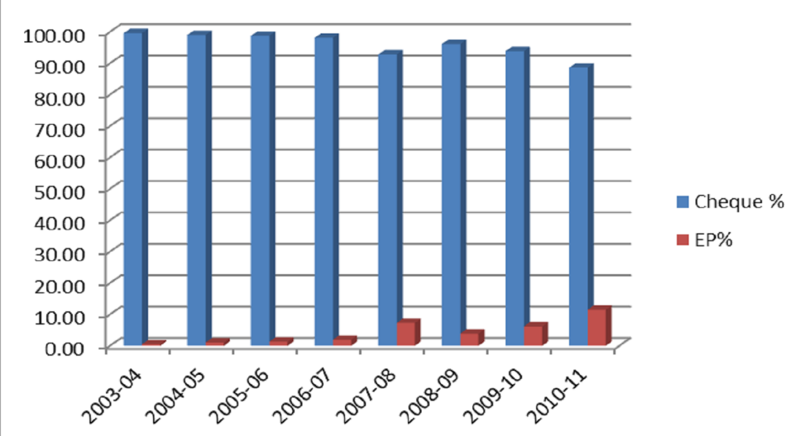
Why CTS? (Cheque truncation system)

Slide 14



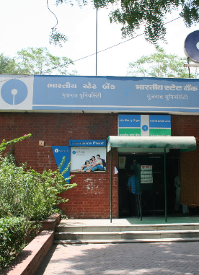
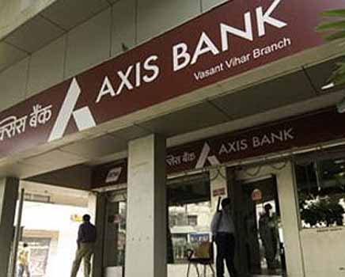

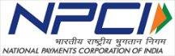

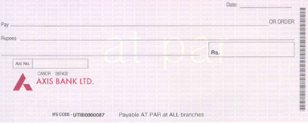
Payee (Recipient)
Drawer (Recipient)
Scanned image
of cheque
Presenting branch retains physical cheque
Drawee branch transfers money

Slide 15
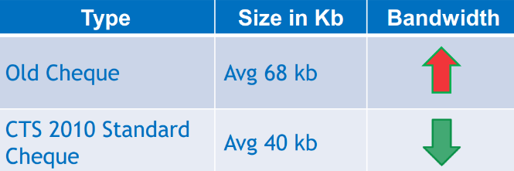

CTS 2010 standard
NPCi
Stop physical movement of cheques…theft, tempering, cost, speed
2010 std: Cheque designs changed
More secure, faster scanning & Easier OCR, smaller image size..

Slide 16
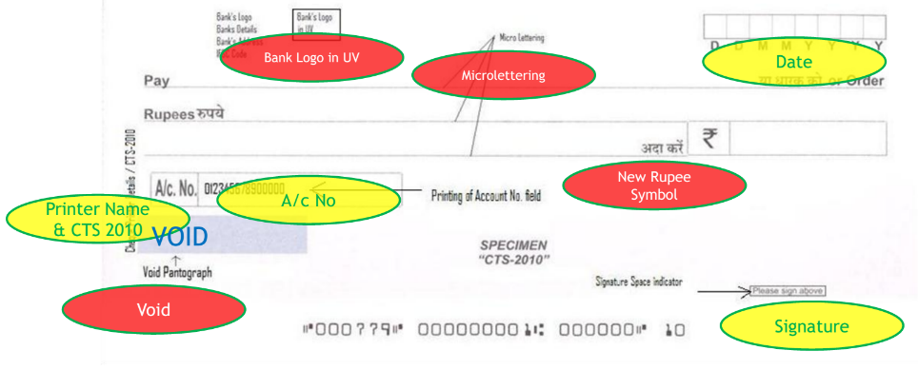

CTS-2010 compliant cheque design
New Rupee symbol: through competition by Dept of Eco.Affairs
D.Udaya Kumar (Associate Professor @IIT Guwahati)
15/July/2010

Slide 17
Bank Money?
Cheque: can be dishonored.
Demand Draft: no stamping, extra charge depending on amt, can’t be dishonored.
Overdraft: can withdraw excess of balance
And more for IBPS…. But do self-study
Bank account
Current Account
Savings Account
Bank Money
Paper order
Electronic Orders
Payment
Spot
Deferred
FD
Fiat money
Post demonetization, this topic gained limelight

Slide 18
Theory (Paper order + E-order) +Current: Digital payment
Ratan Watal Committee by FinMin (16’Dec)
Medium term reco. To strengthen digital payment ecosystem.
C.Babu Naidu chief ministers’ Committee to PM (16’Nov-’17 Jan)
Promote digital payment
BES17
Budget provisions
Ch.3 partial (HW: intro, conclusion)
Yojana’ Feb17
Less cash economy
HW: editor’s note, intro, conclusion
But before we go into such analytical, descriptive areas for MAINS and Interview…first let’s learn objective, factual, MCQ type theory for prelims

Slide 19
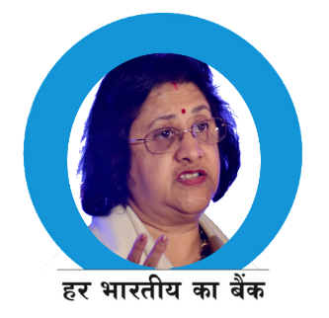
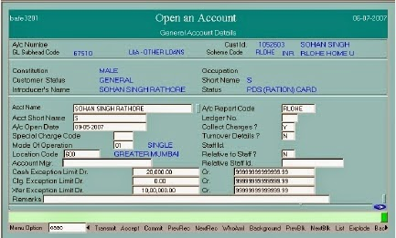
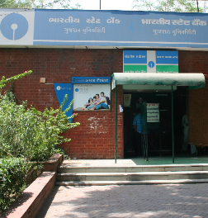
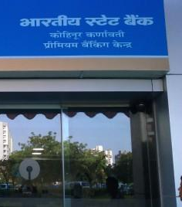
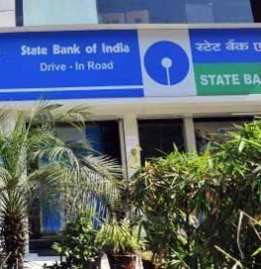

Core Banking solution =software with web-platform
Branch banking -> Centralized banking, data management, synchronization
Finacle (Infosys); BanCS (TCS)

Slide 20
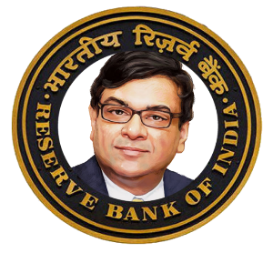

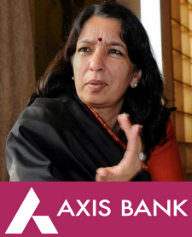
RBI is banker’s bank & Banks have current accounts@RBI
E-Kuber: CBS of RBI
PSLC trading also done here
Notes:
Core banking solution: "Software" with web based platform
Only then e-banking, mobile banking, card banking possible.
Infosys- Finacle; i-flex: Flexcube
e-Kuber is a core banking solution of RBI. e-Kuber provides the provision of a single current account for each bank across the country, with decentralised access to this account from anywhere-anytime using portal based services in a safe manner
For details, see https://www.rbi.org.in/scripts/BS_ViewBulletin.aspx?Id=14283

Slide 21
UPSC CSAT-2016
The term ‘Core Banking Solutions’ correct term?
It is a networking of a bank’s branches which enables customers to operate their accounts regardless of where they open their accounts.
It is an effort to increase RBI’s control over commercial banks through computerization.
It is a detailed procedure by which a bank with huge non-performing assets is taken over by another bank.
Answer (a) 1 only (b) 2 and 3 only (c) 1 and 3 only (d) 1, 2 and 3
Had they asked “Find incorrect statement about CBS”..

Slide 22
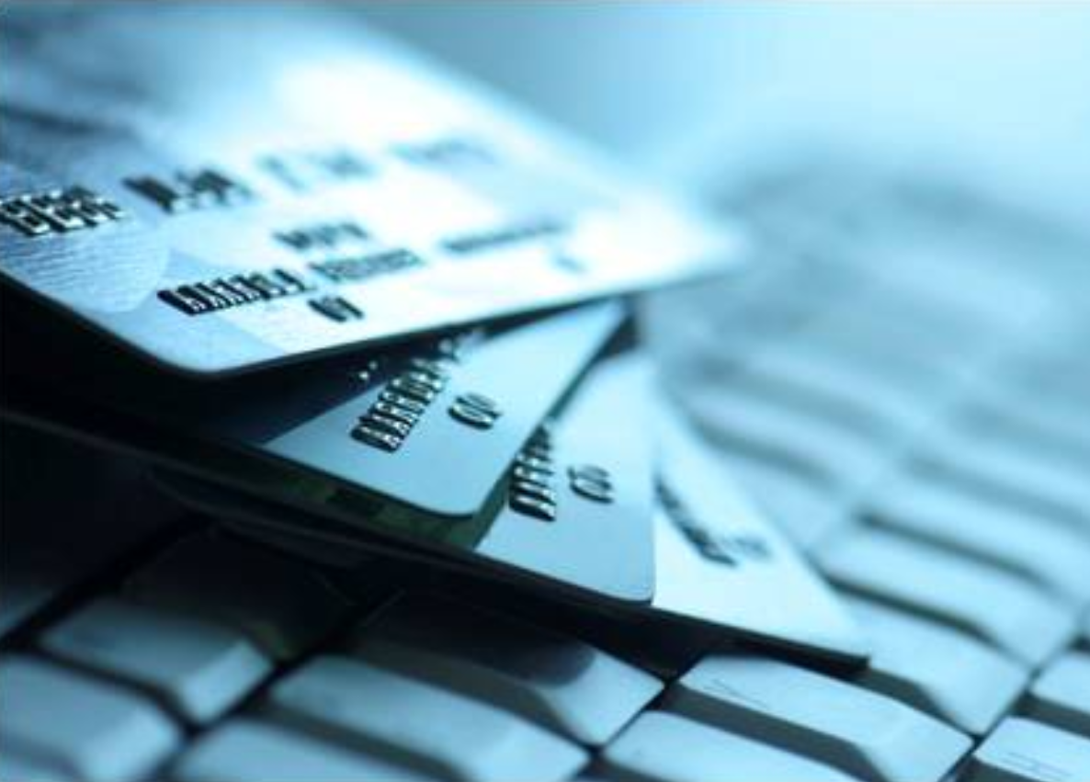


Digital Payment systems: classification of
Digital Payment System
Real time
Immediate Payment Service (IMPS)
Delayed Settlement
National Electronic Clearing Service (NECS)
Cards system (Visa, MasterCard and RuPay).
National Electronic Fund Transfer (NEFT)
National Automated Clearing House (NACH)
Real Time Gross settlement (RTGS)
Unified Payment Interface (UPI)
SBIBuddy,
Phonepe (Flipkart +YesBank)
AxisPay
Narsimhan-II’98-> Payment & Settlement Act 2007-> RBI supervise..
All system providers have to register
Banks can access directly; Non-Banks have to tieup with member bank.

Slide 23
Mock question
Which of the following acronym is correctly matched?
IMPS: instant money payment service
NEFT: Net electronic fund transfer
UPI: united payment interface.
RTGS: real time gross settlement

Slide 24




NEFT: Hourly settlement but only in weekday (8AM-7PM)
A settlement system where a large number of transactions are accumulated and offset against each other, with only the net difference being transferred at the end of a given settlement cycle.
Sending | SBI | Axis
customer#1 | 5 | 5
customer#2 | 5 | 3
Total (8AM-9AM) | 10 | 8
NET (incoming) | -2 | 2

Slide 25

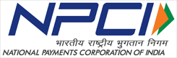
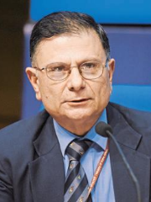
All of them should run 24x7
Allow non-banks to participate directly-> “Innovation. “R.Gandhi disagrees” with tickbox approach
In future, think about separating from RBI ..like DoT-> BSNL
Type
NEFT
RTGS
Min
Any amt
Max
10 lakh
500 cr.
2 lakh
10k (Mobile) 2L(IFSC)
IMPS
Rs. 1
Charges
2.50 to 25
5-15
25-50
Weekdays
Weekdays
24x7
Available
Depending on amt + service tax extra
Notes:
http://indianexpress.com/article/business/banking-and-finance/watal-committee-recommendations-reserve-bank-differs-on-some-proposals-of-payment-panel-4535329/
Depending on bank, number and timing may vary
need corporate banking account
https://www.onlinesbi.com/personal/neft_rtgs_faq.html
4. When does the beneficiary get the credit for a RTGS payment?
Under normal circumstances the beneficiary Bank branch receives the funds in real time as soon as funds are transferred by the remitting Bank. The beneficiary Bank has to credit the beneficiary's account within two hours of receiving the funds transfer message.
5. When does the beneficiary get the credit for a NEFT payment?
As stated above, NEFT operates in hourly batches. Currently there are twelve settlements from 8 am to 7 pm on week days. Therefore, the beneficiary can expect to get the credit for the transactions put through between 8 am to 5 pm on weekdays on the same day. For transactions settled in the 6 and 7 pm batches on week days, the credit will be afforded either on the same day or on the next working day.

Slide 26
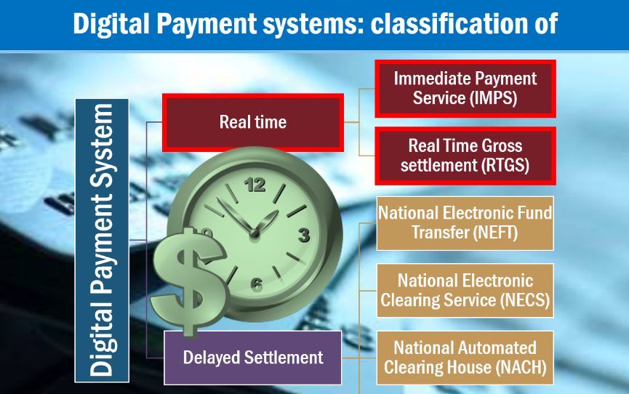





Slide 27
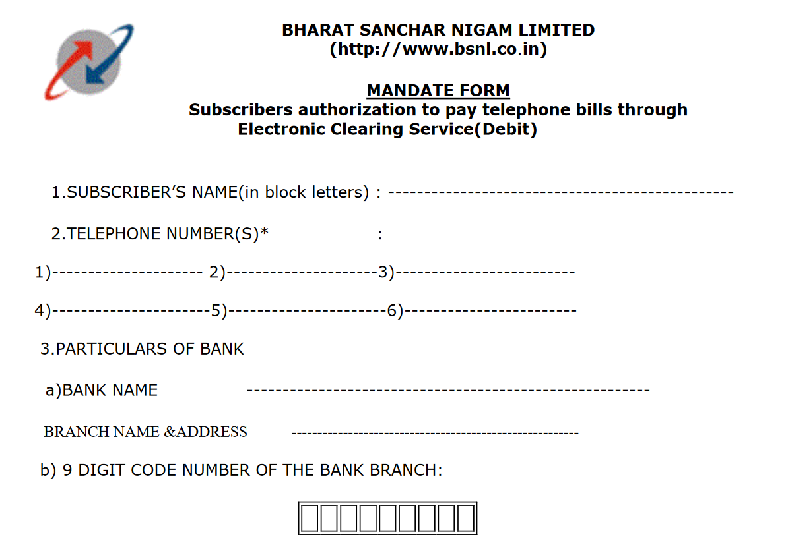
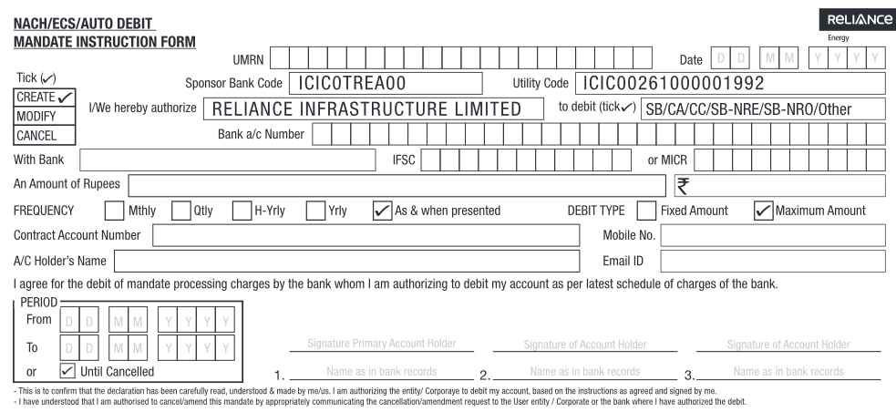

Slide 28

Delayed settlement of “automated Bulk payment”: ECS, NACH
ECS
Local & regional- designated SCB;
NACH
All India NPCi
National-RBI
Customers
Companies
Automated monthly paying telephone, electricity, DTH, EMI, insurance premium
Bulk distribution of salaries, pension, dividend, bond-interest
Government
Aadhar Enabled DBT to PMJDY Account ; UBI!?
Most banks shifting to NACH

Slide 29
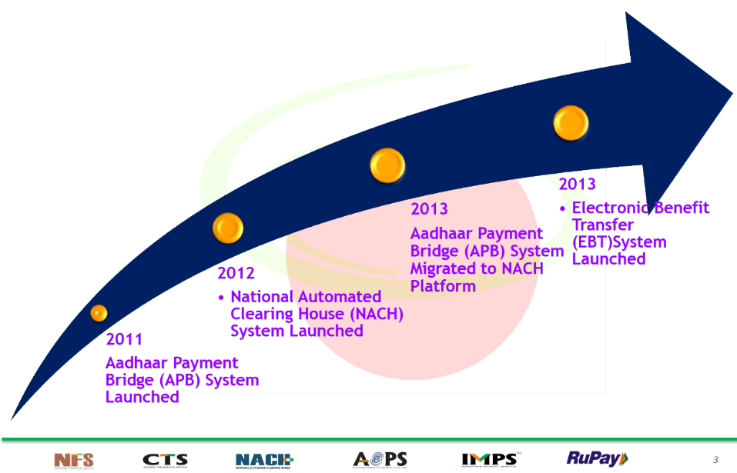


Slide 30

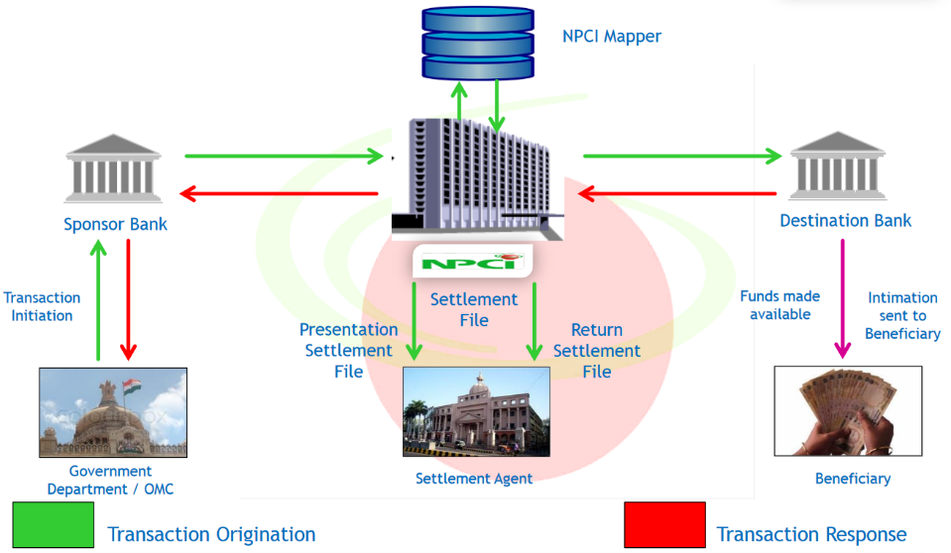


NACH: IT system how does it work?

Slide 31

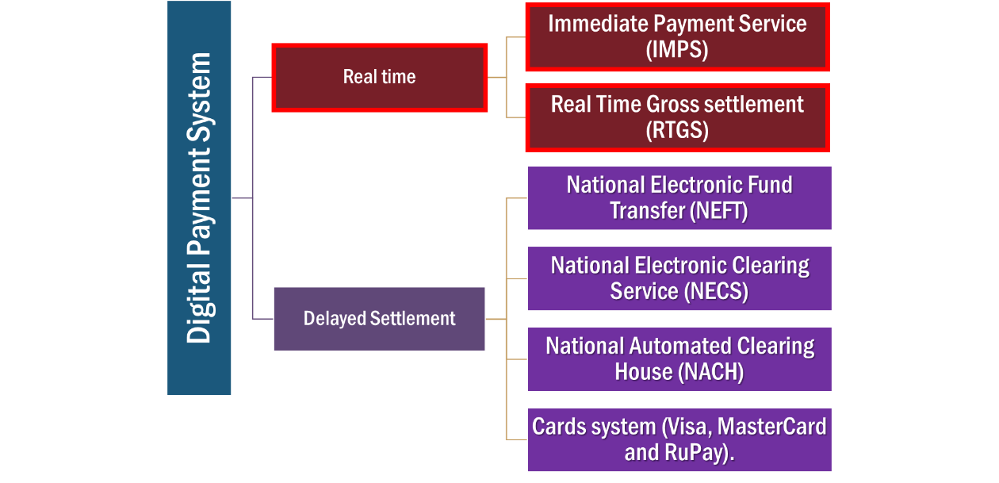

Slide 32



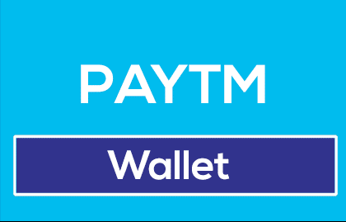

MIND the difference
Entertainment “systems“
Entertainment providers
Hero
DTH
Cinema
Soap opera star
Digital Payment “systems“
Providers
Bank
Real Time
Delayed
Non-Bank

Slide 33

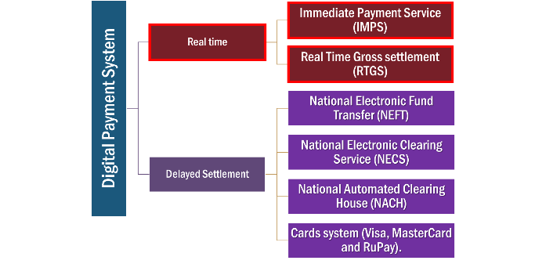

Providers
Bank
ATM
NEFT-RTGS
Non-Bank
ATM (White Label)
Wallet, App, IMPS, UPI
Wallet, App, IMPS, UPI
Cards
Cards network (Master card, Visa)
Cross border

Slide 34

RBI’s Classification: (Digital) Payment service providers (PSP)
CrossBorder Money transfer –In Bound (8)
Western Union, Moneygram
Instant money transfer (IMT) outbound
Empays-> banks
1 Financial Market Infrastructure (FMI)-
Clearing corp. of India ltd. (G-sec, Money market, forex)
Retail Payments Organisation -1 NPCI
CTS, NACH, NFS (ATM), AEPS, IMPS, UPI
ICICI->Blockchain->Emirates Bank Dubai
Must reg.@RBI under Payment and settlement system Act 2007

Slide 35
RBI’s Classification:(Digital) Payment service providers (PSP)
Card payment network (5)
PPI, m-Wallet (48)
American Express, Mastercard, Visa, Diners club
DESHI: NPCI's Rupay
Paytm (One97)
Phonepe (Flipkart)
PayU, Airtel money,
Freecharge
QwikCilver (Amazon giftcard)
JioMoney (Mukeshbhai)
Mobo Money (Tech Mahindra)
Vodafone M-Pesa
ATM
Banks
Brown label
White label (8)
Must reg.@RBI under Payment and settlement system Act 2007

Slide 36
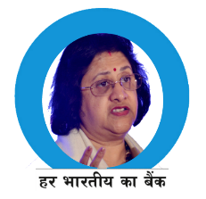


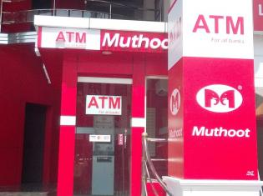

Now small banks and payment banks interested to tie up, since they can’t afford to run a large network on their own.
CBS portal
CBS portal
Sponsor bank gives cash
Bank label
Whitelabel
Brown
Non Bank
Outsourced
Itself
WHITE LABEL (non-Bank owns & operates)

Slide 37

Authorized non-bank entities under Payment & Settlement Act ‘07
White label ATM
Tata Communications (Indicash)
Muthoot Finance Ltd.
Hitachi Payment Services Pvt. Ltd.
AGS Transact Technologies Ltd.
BTI Payments Pvt. Ltd.
RiddiSiddhi Bullions ltd -
SREI Infrastructure Finance Ltd.,
Vakrangee ltd
2013 RBI License for White label ATM
1:2= urban: (semiurban+rural)
Total ~13k by 2016

Slide 38
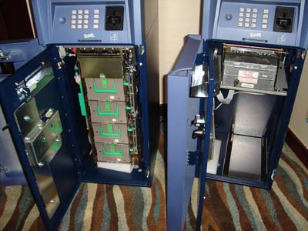
Demonetization and Automated teller Machine
BEFORE
1000
After
2000
500
500
500
100
500
100
Size change and software update
Could be 2 or 4 cassettes
Notes:
(15-20L
Before demonetization, banks charged a transaction fee if a customer performed more than five transactions on their ATM network.

Slide 39
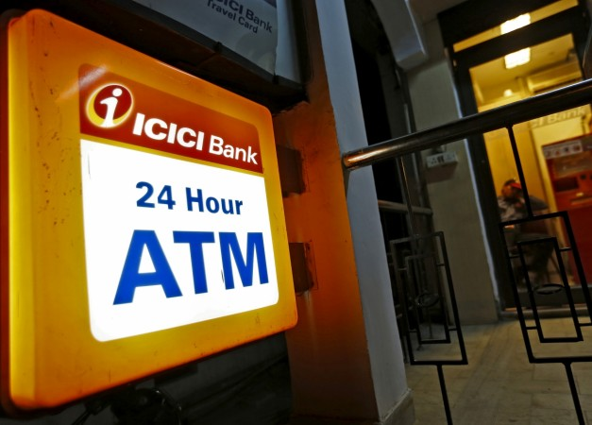
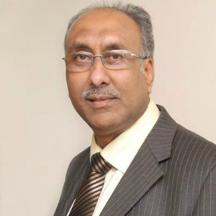
Demonetization: ATM re-calibration
ICICI claims to be the 1st to recalibrate
~30 minutes per ATM
Dy.Gov SS Mundra taskforce 2016: to recalibrate ATMs for new 500-2000 notes

Slide 40
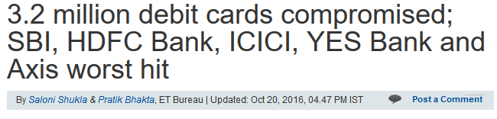
ATM software: WinXP but support ended
Vortex
Hitachi
Win7->Malware
Linux
Desi Co.
Japanese, now “Make in India”
CDAC project: Bharat Operating Systems Solutions (BOSS) LINUX.
May be in future, could be used.

Slide 41
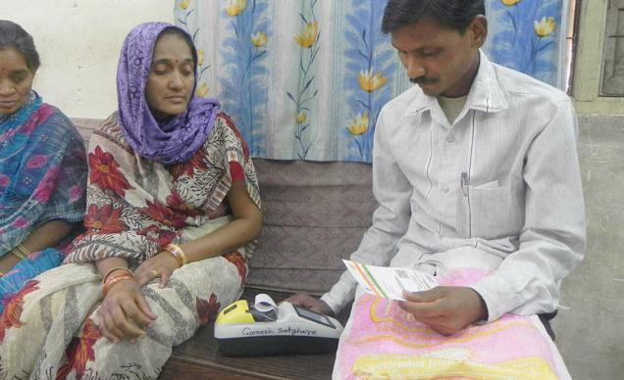
“Micro”ATM= “DESHI Jugaad”?
BC / shopkeeper gives cash manually
Budget 2017
0% Custom, excise duty
PoS, Card, Aadhar enabled fingerprint scanner

Slide 42
RBI’s Classification:(Digital) Payment service providers (PSP)
Card payment network (5)
PPI, m-Wallet (48)
American Express, Mastercard, Visa, Diners club
DESHI: NPCI's Rupay
Paytm (One97)
Phonepe (Flipkart)
PayU, Airtel money,
Freecharge
QwikCilver (Amazon giftcard)
JioMoney (Mukeshbhai)
Mobo Money (Tech Mahindra)
Vodafone M-Pesa
ATM
Banks
Brown label
White label (8)
All Must reg.@RBI under Payment and settlement system Act 2007

Slide 43

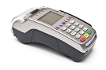

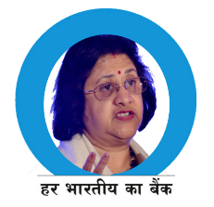

Merchant
Can’t have world wide reach
Duplication of effort
Merchant
Merchant
Client

Slide 44

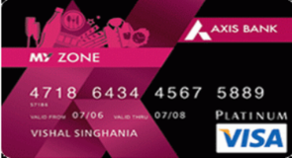
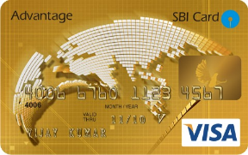

Merchant
Merchant
Visacard,
Payment gateway
Merchant
300 cr./ year
Merchant Discount rate (MDR) per transaction
Annual charges of credit / debit card
Merchant
Client

Slide 45
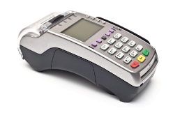
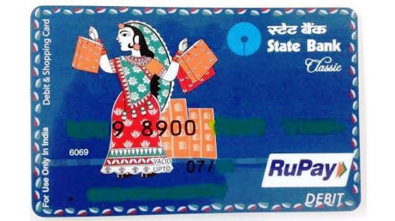





300 cr./ year
40% less
NPCi’s RuPay
Merchant

Slide 46

Rupay rupee + payment
NPCi
Mastercard, Visacard, China’s Union Pay..Rupay 7th Payment gateway in world
3 channel: ATM, PoS, Online
Cashback, airport lounge access etc.
Used by commercial, coop, PSB, private banks; even railway and dairies.
Free with PMJDY; 1 lakh accident Insurance cover only if rupay card used /45 days. (NPCi)*
Notes:
Not for Income tax payers.

Slide 47
Credit card: Chronology (self study for bank exam)
1920
Mobile Oil, USA – first credit card in the world
1964
Diners club card – first credit card in India
1981
Andhra bank + Visa tie up: first credit card by bank
Then Canara + Master card tie up.
1946
Brokkyn: John C Biggins gives “charge it” credit plan… this is basis of consumer credit card for FMCG
1987
HSBC bank installed first ATM in India @Mumbai

Slide 48
Card Types (self study for bank exam)
Credit Card: “grace period”
Majority – issued by PVB
Debit cards: “No grace period”
Majority – issued by PSB
ATM card
Debit card “Hybrid”
Only for ATM
Like ATM card- withdraw cash
Like Credit card- Pay @PoS, online but immediate deduction, no grace period.
Prepaid cards
Stored value, specific usage
Status
Issuer
Gold, platinum,….
Credit limit
Ownership
Individual
corporate
Franchisee: Master card, Visa card, Rupay card (Bank gets franchisee)
Proprietary: SBI itself

Slide 49

Card technologies
Magnetic (60s technology)
Data on magnetic strip.
Data can be duplicated, cloned, skimmed = fraud.
EMV: Europay+Mastercard+Visa
chip infrastructure with encryption. RBI ordered migration (2013)
EMV-contact: must remain inside terminal. Chip&PIN | Chip&Signature.
EMV-contactless: simply tap the card on terminal. (RFID)

Slide 50

Card technology
NFC: Nearfield communication tech.
Contactless payment / datasharing possible,
Range: ~few cm. eg. Apple Pay. BHIM
via Encrypted electromagnetic Radio tech.
RFID: Radio frequency Identification
no power source: range ~25m
logistic, vehicle detection. Toll pay ICICI-FAStag prepaid card
With power source: upto 100m

Slide 51
UPSC CSAT 2015
82. Correct statements about NFC?
It is a contactless communication technology based on electromagnetic radio fields.
NFC devices can be used at a distance of even a metre from each other.
NFC can use encryption when sending sensitive information.
Answer Codes
A) 1 and 2 Only B) 2 Only
C) 1 and 3 only D) 1, 2 and 3

Slide 52
UPSC CSAT 2015
82. Correct statements about NFC?
It is a contactless communication technology based on electromagnetic radio fields.
NFC devices can be used at a distance of even a metre from each other.
NFC can use encryption when sending sensitive information.
Answer Codes
A) 1 and 2 Only B) 2 Only
C) 1 and 3 only D) 1, 2 and 3

Slide 53
UPSC CSAT 2015
82. Find incorrect statements about NFC?
It is a contactless communication technology based on electromagnetic radio fields.
NFC devices can be used at a distance of even a metre from each other.
NFC can use encryption when sending sensitive information.
Answer Codes
A) 1 and 2 Only B) 2 Only
C) 1 and 3 only D) 1, 2 and 3
Always keep habit of ‘circling…. underlining’ in question paper

Slide 54

3D secure technology? (XML protocol for RBI compliance)
Hence possible to use DEBIT cards online shopping
Amazon
Master/Visa
SBI
Authentication @3 domains

Slide 55








Slide 56




ATM + this
Notes:
NETC = fastag

Slide 57
Immediate Payment Service (IMPS) 2010, Nov.
NPCi
NEFT: only in working hrs, in batches
RTGT: only in working hrs, real time.
IMPS: 24x7 via mobile, internet, ATM.
Built on NFS switch.
Banks build their own apps/portals around it. NPCi intermediary.
Bank => Sender’s mobile =>IMPS => NFS =>receiver => Bank
USSD based also: *99#
Notes:
even Shirdi -> Andhra bank donation.

Slide 58
Before we understand UPI and BHIM…
HTML
SQL RDBMS
CSS
PHP ASP.NET
[CMS]: Wordpress| Joomla | Drupal
Frontend Website

Slide 59

Before we understand UPI and BHIM…
Wordpress CMS (Content management system)

Slide 60


Wordpress Platform
Post
Menu
Contact page
Comment section
Updates for new articles
Notes:
Drupal: mygov group

Slide 61




NPCi’s Unified Payment Interface (UPI)
App
Push transaction
(Remittance)
Pull Transaction (monthly bill deduct)
QR Scan & Pay
Bill sharing among friends

Slide 62





Slide 63


USSD
Unstructured Supplementary Service Data (USSD) on Global system for mobile (GSM)
*123# for balance| ….
*99# for UPI banking.
Ratan WATAL observed:
Mobile banking charges for USSD per session: Rs.1.50-> 0.50 (TRAI)
But even if transaction fails, service charge levied. (Failure rate ~50%)
RBI TRAI jointly hv2 workout.

Slide 64


Slide 65
Sawan jo aag lagaaye…Wikipedia self “Wikipedia” par page bnaaye
Similarly…NPCI—self app bnaaye (technically wrong analogy ofcourse)
one app to access any Bank account
Each bank developed their own app
ATM + this

Slide 66

Bharat Interface for Money (BHIM) for android, ioS
By National Payment Corporation of India
Unified Payments Interface (UPI)- non smart phone *99#
Bank to bank transaction using mobile phone (xyz@upi)
Send/Request Money
Scan & Pay.

Slide 67


Slide 68

Possible to link with Adhar based biometric system
No cards, no hidden charges/MDR..
Notes:
No need for cards, hefty MDR fees by visa, mastercard
Send receive money through smartphone and feature phone
Biometric payment system with Adhar authentication

Slide 69

What’s the difference?
UPI “BASED”
Mrunal@hdfc
9825___@airtel
BHIM
Mrunal@UPI
Switch between accounts
No wallet, money stays@bank.
Sweden “Swish” app-> 100% cashless by 2020.

Slide 70

ATM + this

Slide 71

NPCi: “Not for profit company”: 10 promoter banks (2008)
Registered as “Not for profit” (NPO) [“section 8” company] in Companies act 2013
100 cr. Paid up capital. (Rs.300 cr. Authorized)
State Bank of India
Punjab National Bank
Canara Bank
Bank of Baroda
Union Bank of India
Bank of India
ICICI Bank
HDFC Bank
Citibank
HSBC

Slide 72


Rata Watal’s “CRITICISM” on NPCi
Make it more inclusive and participatory
Allow non-banks also

Slide 73
Mcok Question
Find Correct statement
NPCi is a statutory body under payment & settlement act 2007.
NPCi is a PSU under Finance Ministry
It's the nodal agency to implement Jandhan Yojana.
None of above.
Notes:
Dept of financial services.

Slide 74
Application Programming Interfaces (APIs)
eKYC (2012)
E-Sign (2015)
UPI (2016)
Digilocker (2016)
UIDAI: Bizman can do customer verification via biometric / OTP
CCA – Controller of certifying authorities
Aadhar holder can digitally sign document
Reliance Jio
NPCi:
Min. Electronics & IT
Store documents
Mobile banking->BHIM
GSM2: E-gov- applications, success, transparency accountability

Slide 75


Indiastack Application Programming Interfaces (APIs) 2012: nonprofit thinktank "ispirit" + Nandan Nilekani
Further innovation for service delivery, DBT,….
WATAL: Therefore….encourage competition, allow more PSP entities
Notes:
Indiastack Application Programming Interfaces (APIs)

Slide 76



GSM2: development process- role of various “groups”

Slide 77

Direct Carrier Billing
DCB
Prepaid number: certain Rs. In your account.
Use them to various mobile Value Added Services (VASs)- caller tunes, data plans, sms packs
If you could same system to buy physical goods and services->
Prepaid mobile: "Debit card“ (10%)
Postpaid mobile: "Credit card“ (3%)
Amazon app purchase: “netbanking” (1%)
While only 53% adults in formal banking, but 74% have mobile phones!!
But, Payment and settlement system Act 2007 not permit DCB.
RBI, TRAI, DoT regulatory framework required.
Why take so much headache of UPI, IMPS, BHIM etc..?

Slide 78


Slide 79


CBS
DONE
Objective
Factual
MCQ type
For Prelims
Next Time
Analytical
Descriptive
Mains
Interview

